Slide 1
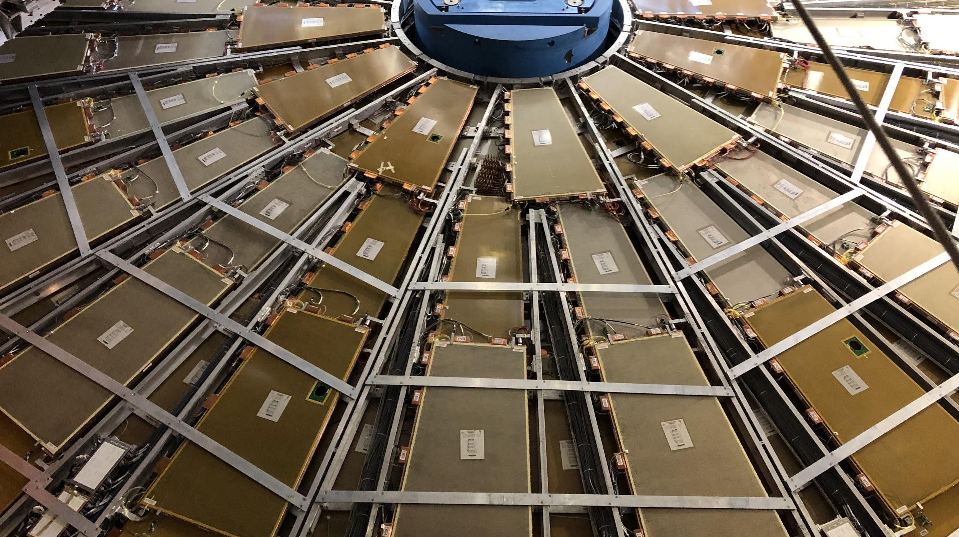


CIS Tech Update
Chicago Weekly Meeting, May 16 2022
Dawit Belayneh and Katie Hughes

Slide 2
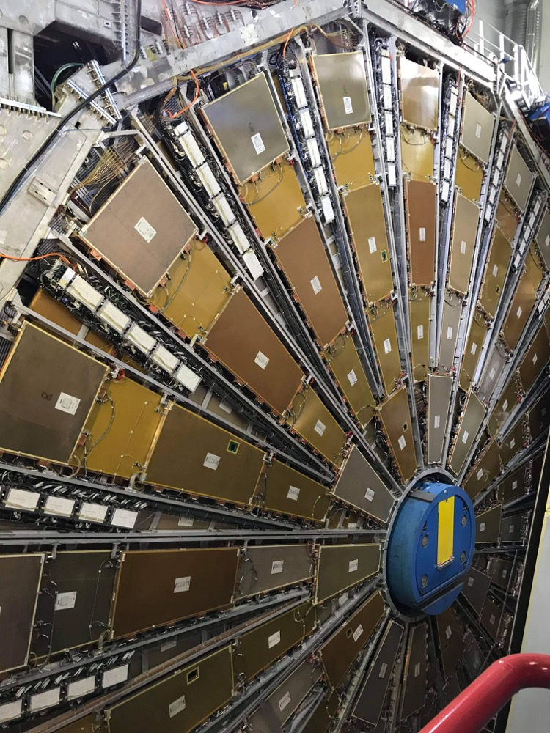
Outline
CIS Updates
ATLAS Control Room Shifts
DQL Shift & Sim Work
A Quick Life Update

Slide 3
Charge Injection System (CIS)

Slide 4
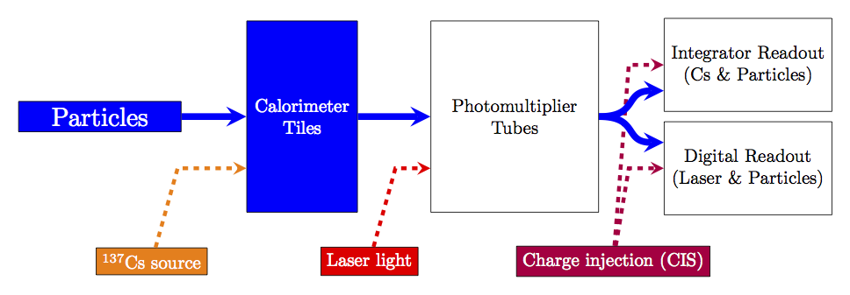
Overview
Calibration system for front-end readout electronics
Simulates physics signals by injecting a known charge and measuring the electronic response
Characterizes each readout channel with a CIS constant

Slide 5
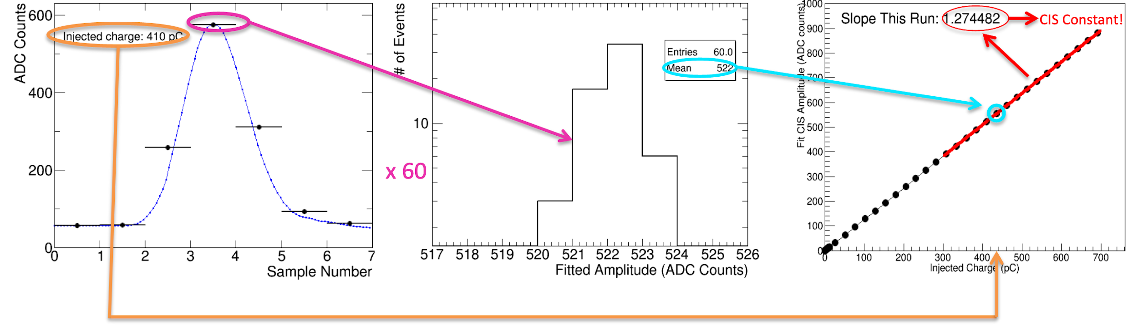
CIS Constant Calculation
60 injections of a set charge sampled 7 times
15 steps varying phase between injection and sampling
4 capacitor discharges each
Mean amplitude of pulse measured for different charges
Amplitude (ADC counts) vs charge (pC) fit gives CIS constant
For each of ~19,700 channels!

Slide 6
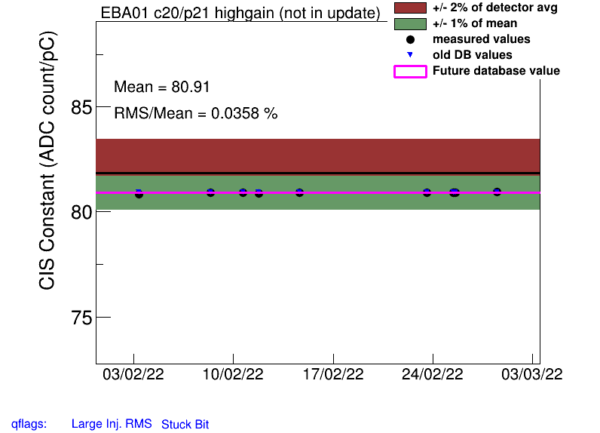
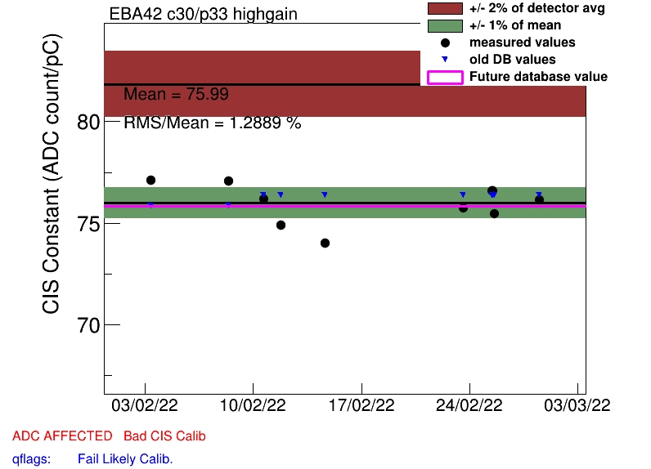
Procedure
Generate plots of CIS constants vs time over last month
Go through plots by hand to check validity of constants
Good CIS plots are very stable over time and close to the detector mean
Manually make any necessary changes/recalibrations
Upload corrected constants to database
Good CIS
Bad CIS

Slide 7
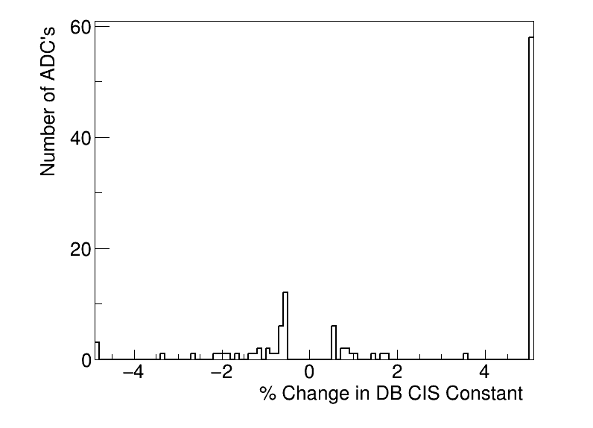
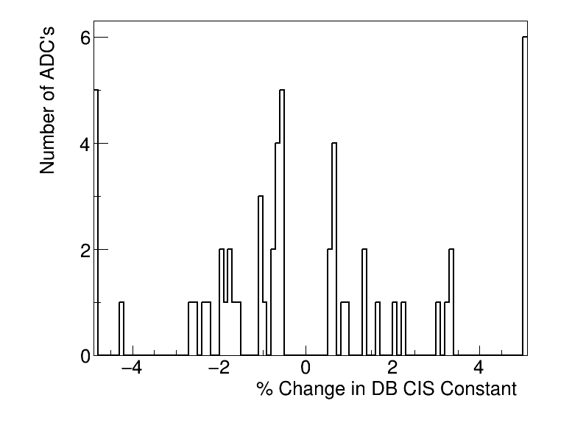
CIS Update Summaries
March
110 channels updated
61 (!!!) with >5% change
April
55 channels updated
9 with >5% change

Slide 8
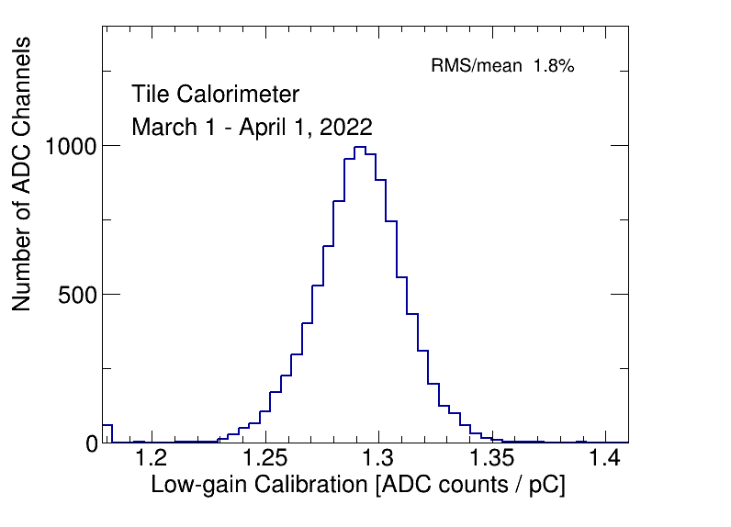
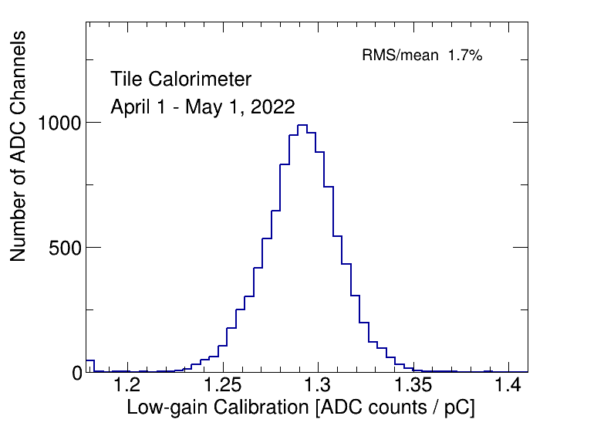
CIS Constant Distributions (Low Gain)
Should be Gaussian and centered around 1.29 ADC counts/pC

Slide 9
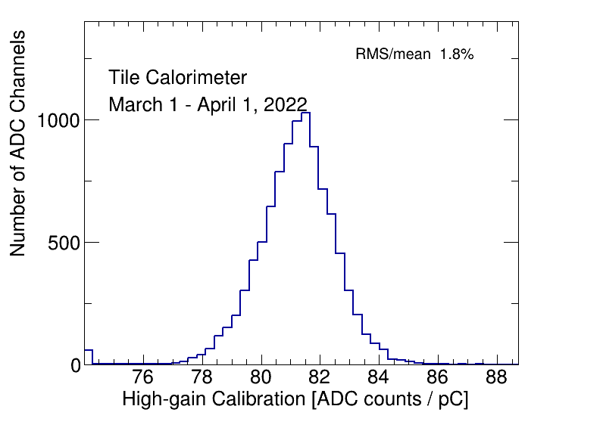
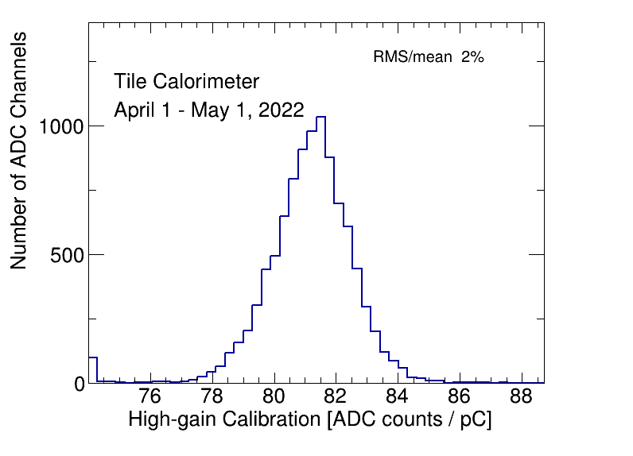
CIS Constant Distributions (High Gain)
Should be Gaussian and centered around 81 ADC counts/pC

Slide 10
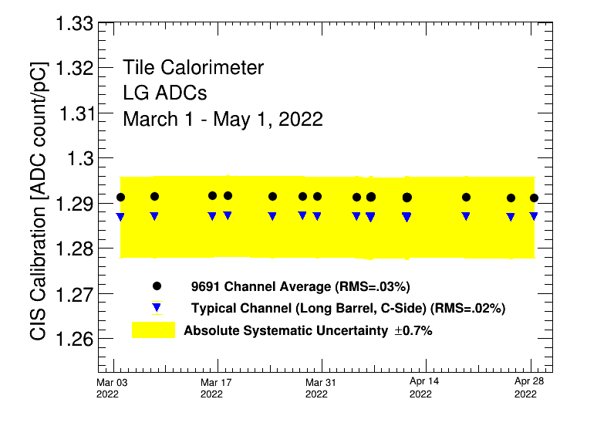
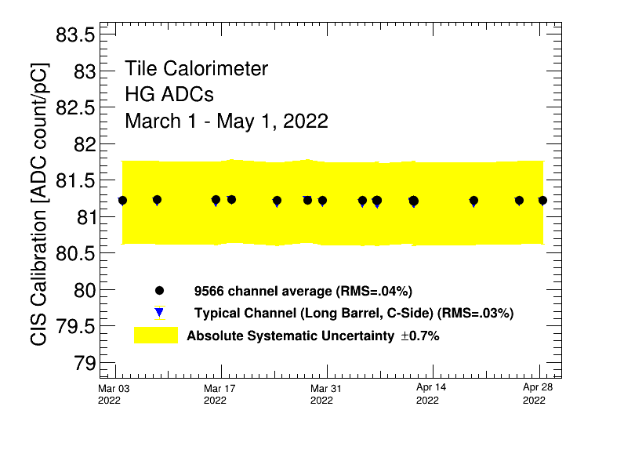
Detector Stability

Slide 11
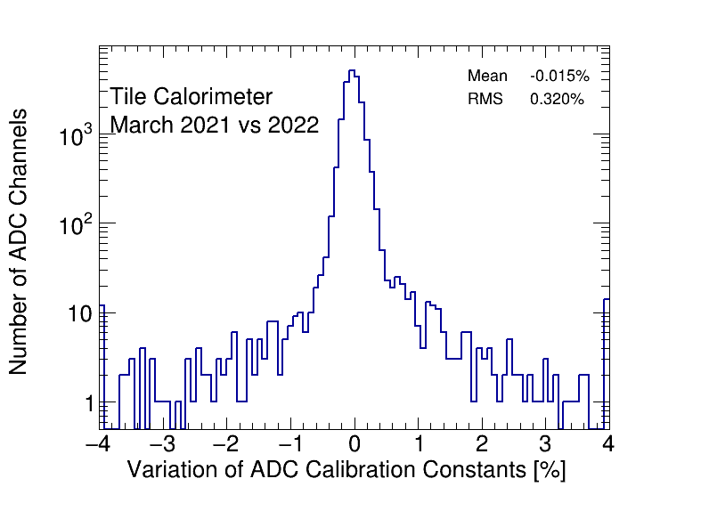
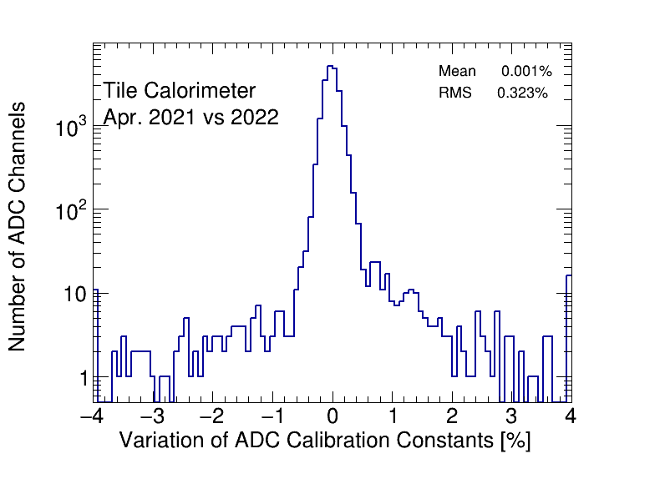
CIS Constant Stability

Slide 12
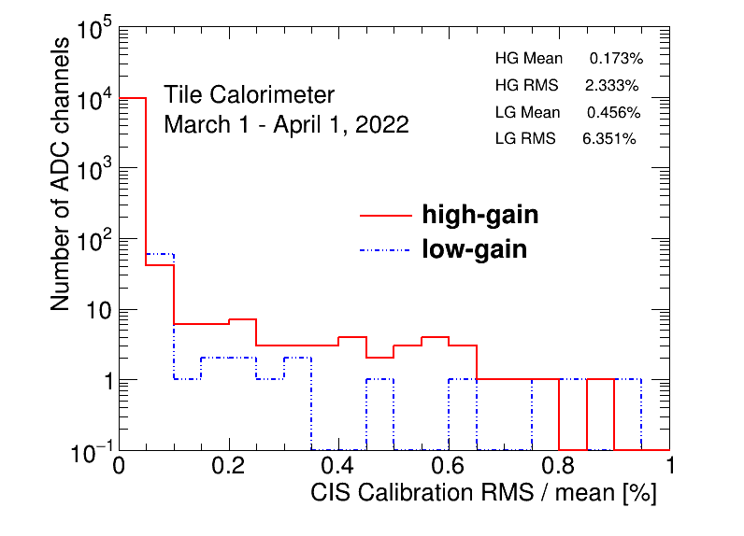
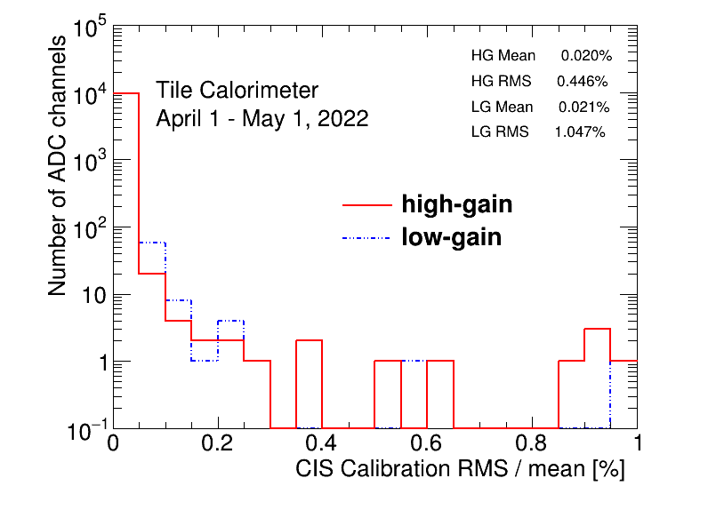
CIS Constant RMS/Mean

Slide 13
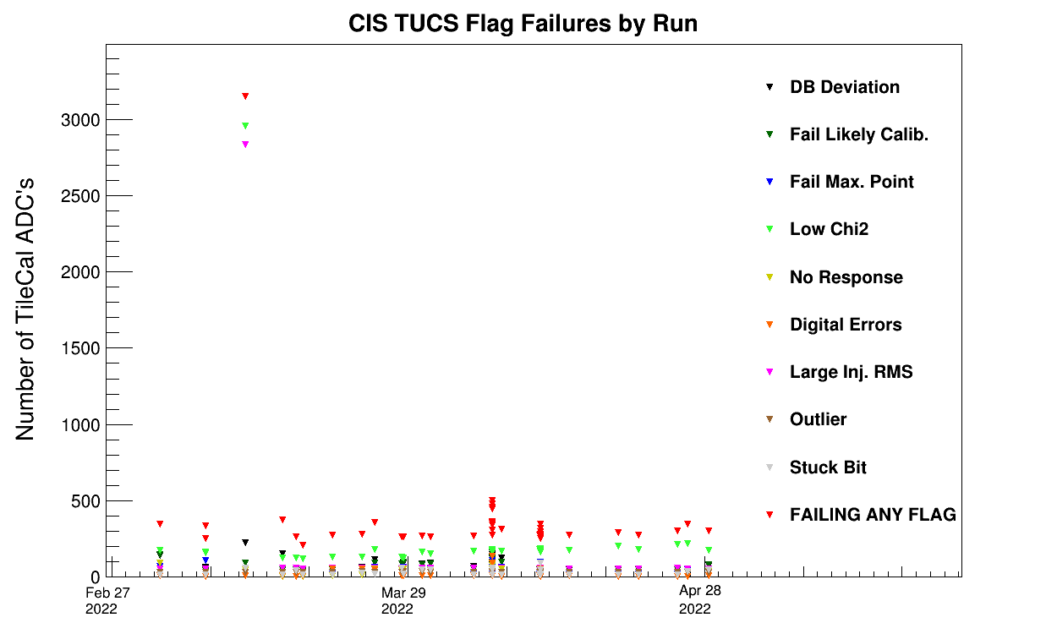
TUCS Quality Flags

Slide 14
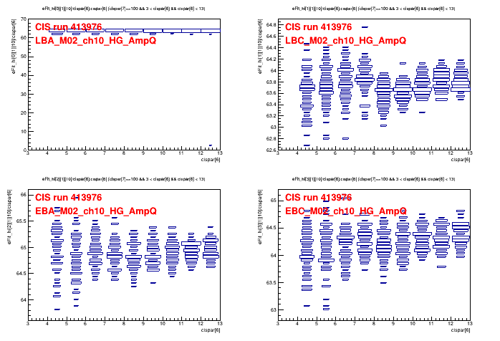
TUCS Quality Flags
This run wasn’t used in the Mar. Update – LBA HG has bad Amp/Charge ratio

Slide 15
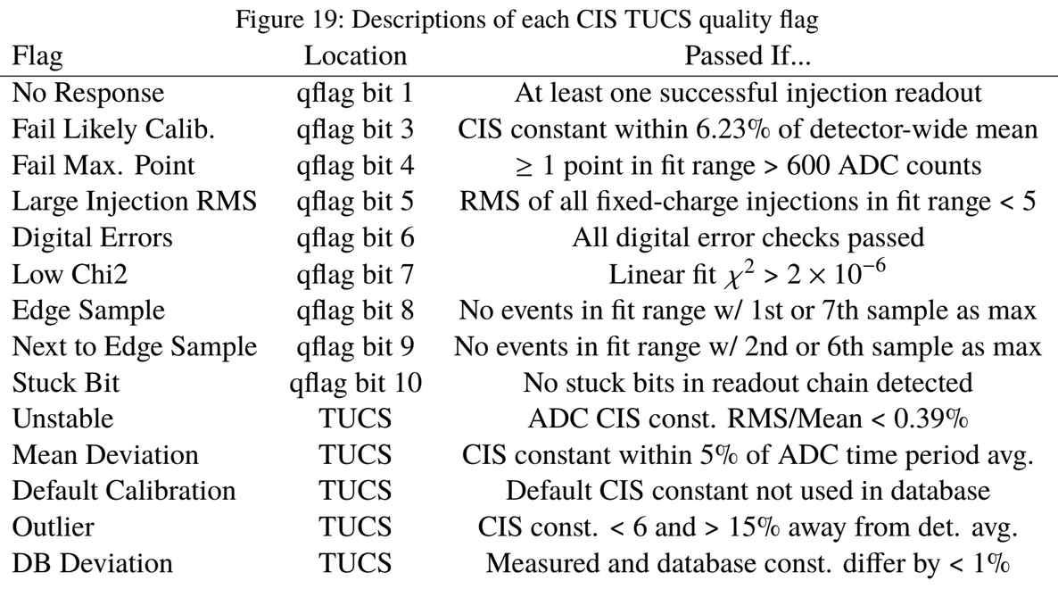
TUCS Quality Flags

Slide 16
“Half Gain Switching”
Abrupt, large jumps in CIS constant (~50% change)
Channels I saw in the most recent update (April) with this behavior:
LBC_m19_c22_lowgain
LBC_m41_c25_highgain
LBC_m47_c35_lowgain
In previous updates (reason why the number of high deviation channels was so high in March):
EBC_m18_c04_lowgain
EBC_m43_ch36-41
EBC_m34_ch39-41_lowgain
LBA_m64_c29_highgain

Slide 17
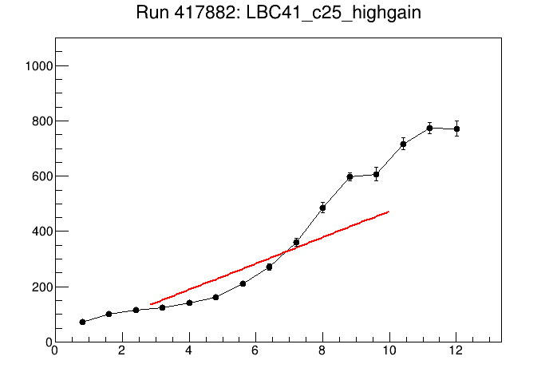
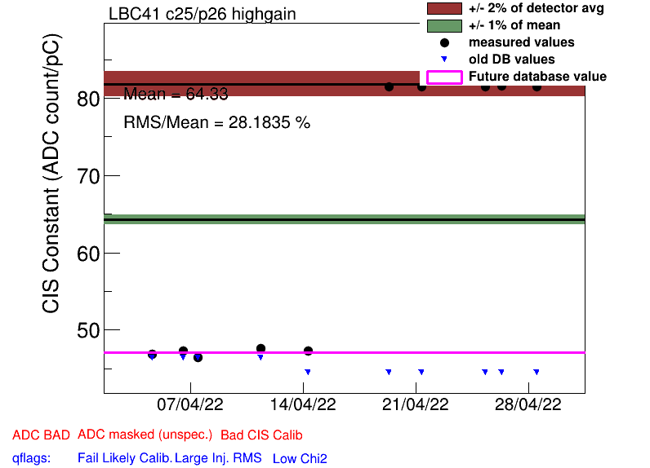
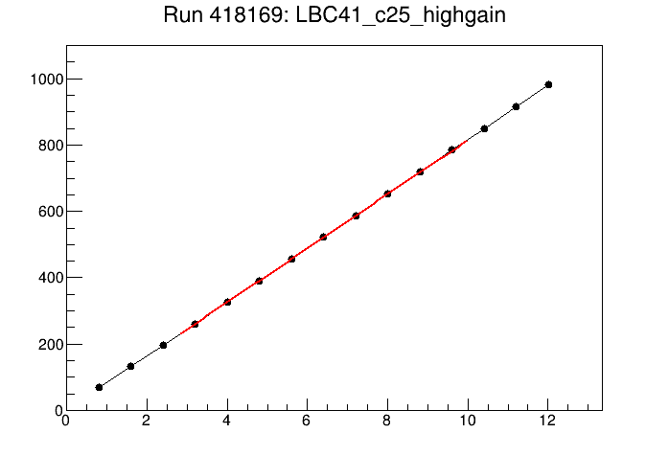
LBC_m41_c25_highgain
1
2
1
2

Slide 18
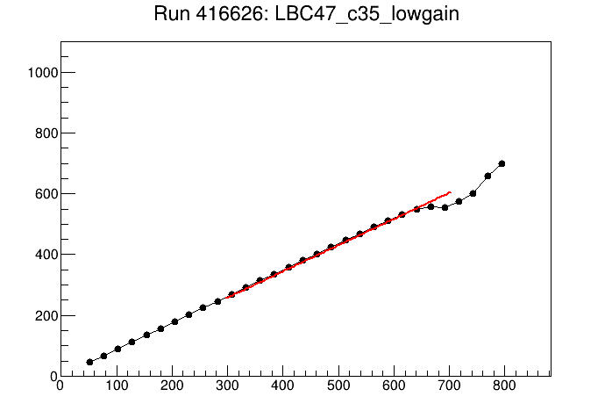
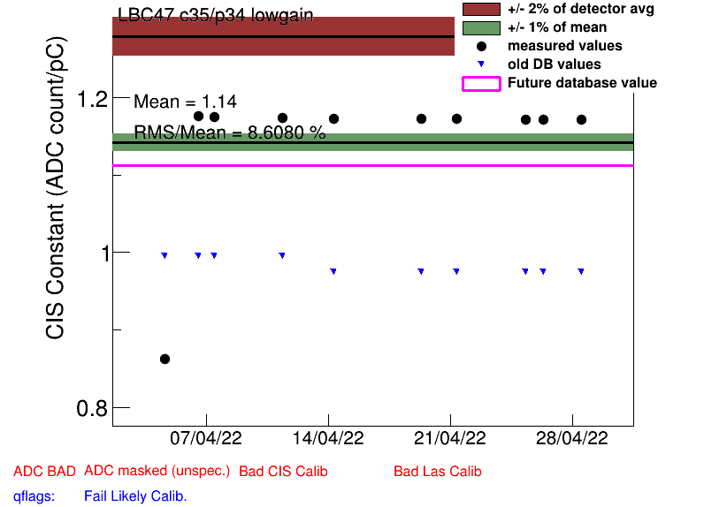
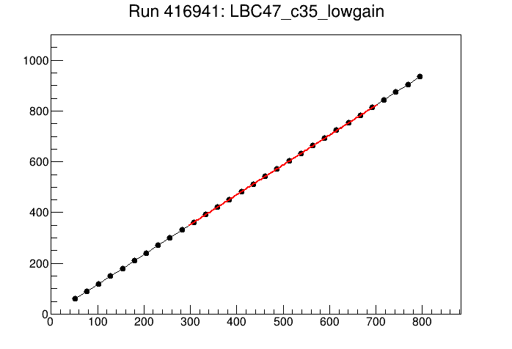
LBC_m47_c35_lowgain
1
2
1
2

Slide 19
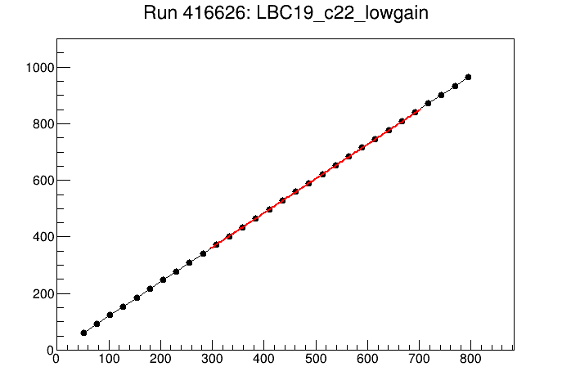
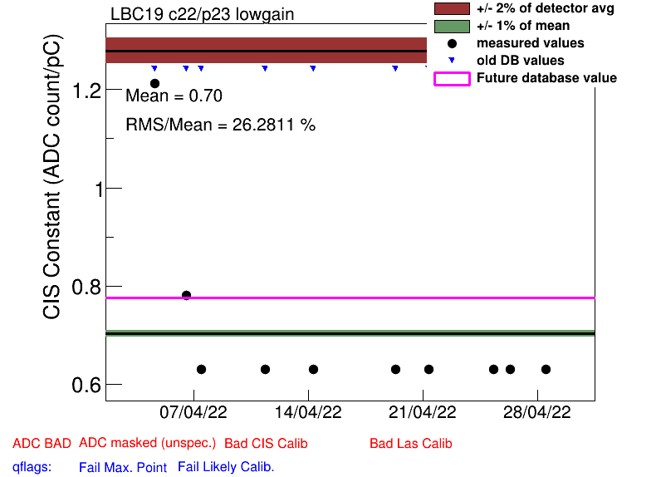
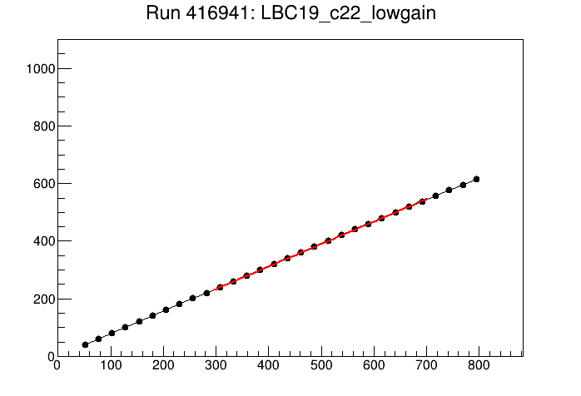
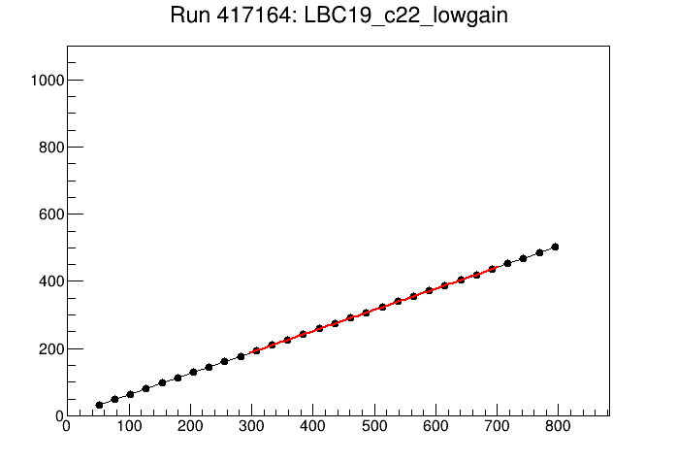
LBC_m19_c22_lowgain
1
1
2
2
3
3

Slide 20
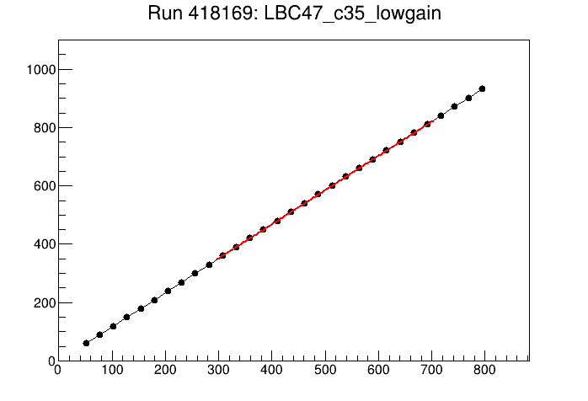
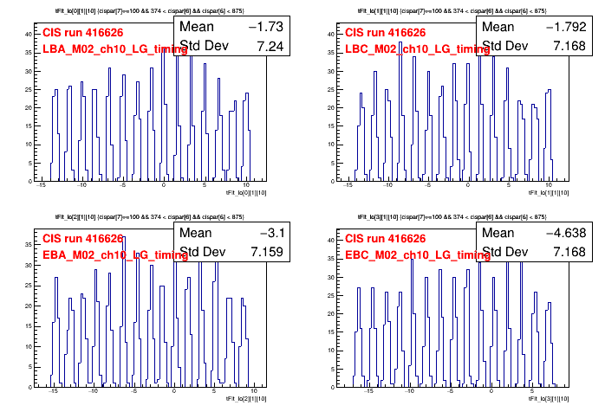
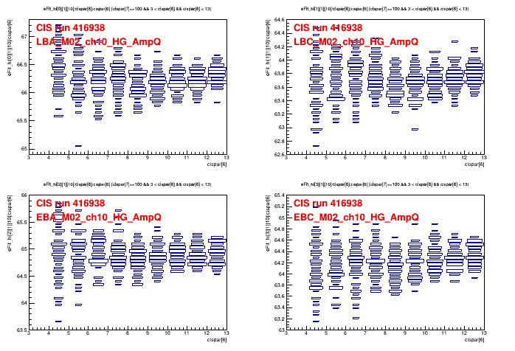
Current Work
New ROOT Macros to:
Easily plot raw CIS runs (ADC count vs pC plots)
Plot all timing and amp/charge plots (useful for choosing good runs to use in update)
Check if pulses are missing from CIS runs
New documentation for next techs
TODO: Macro for pulse shape?

Slide 21
ACR Shifts

Slide 22
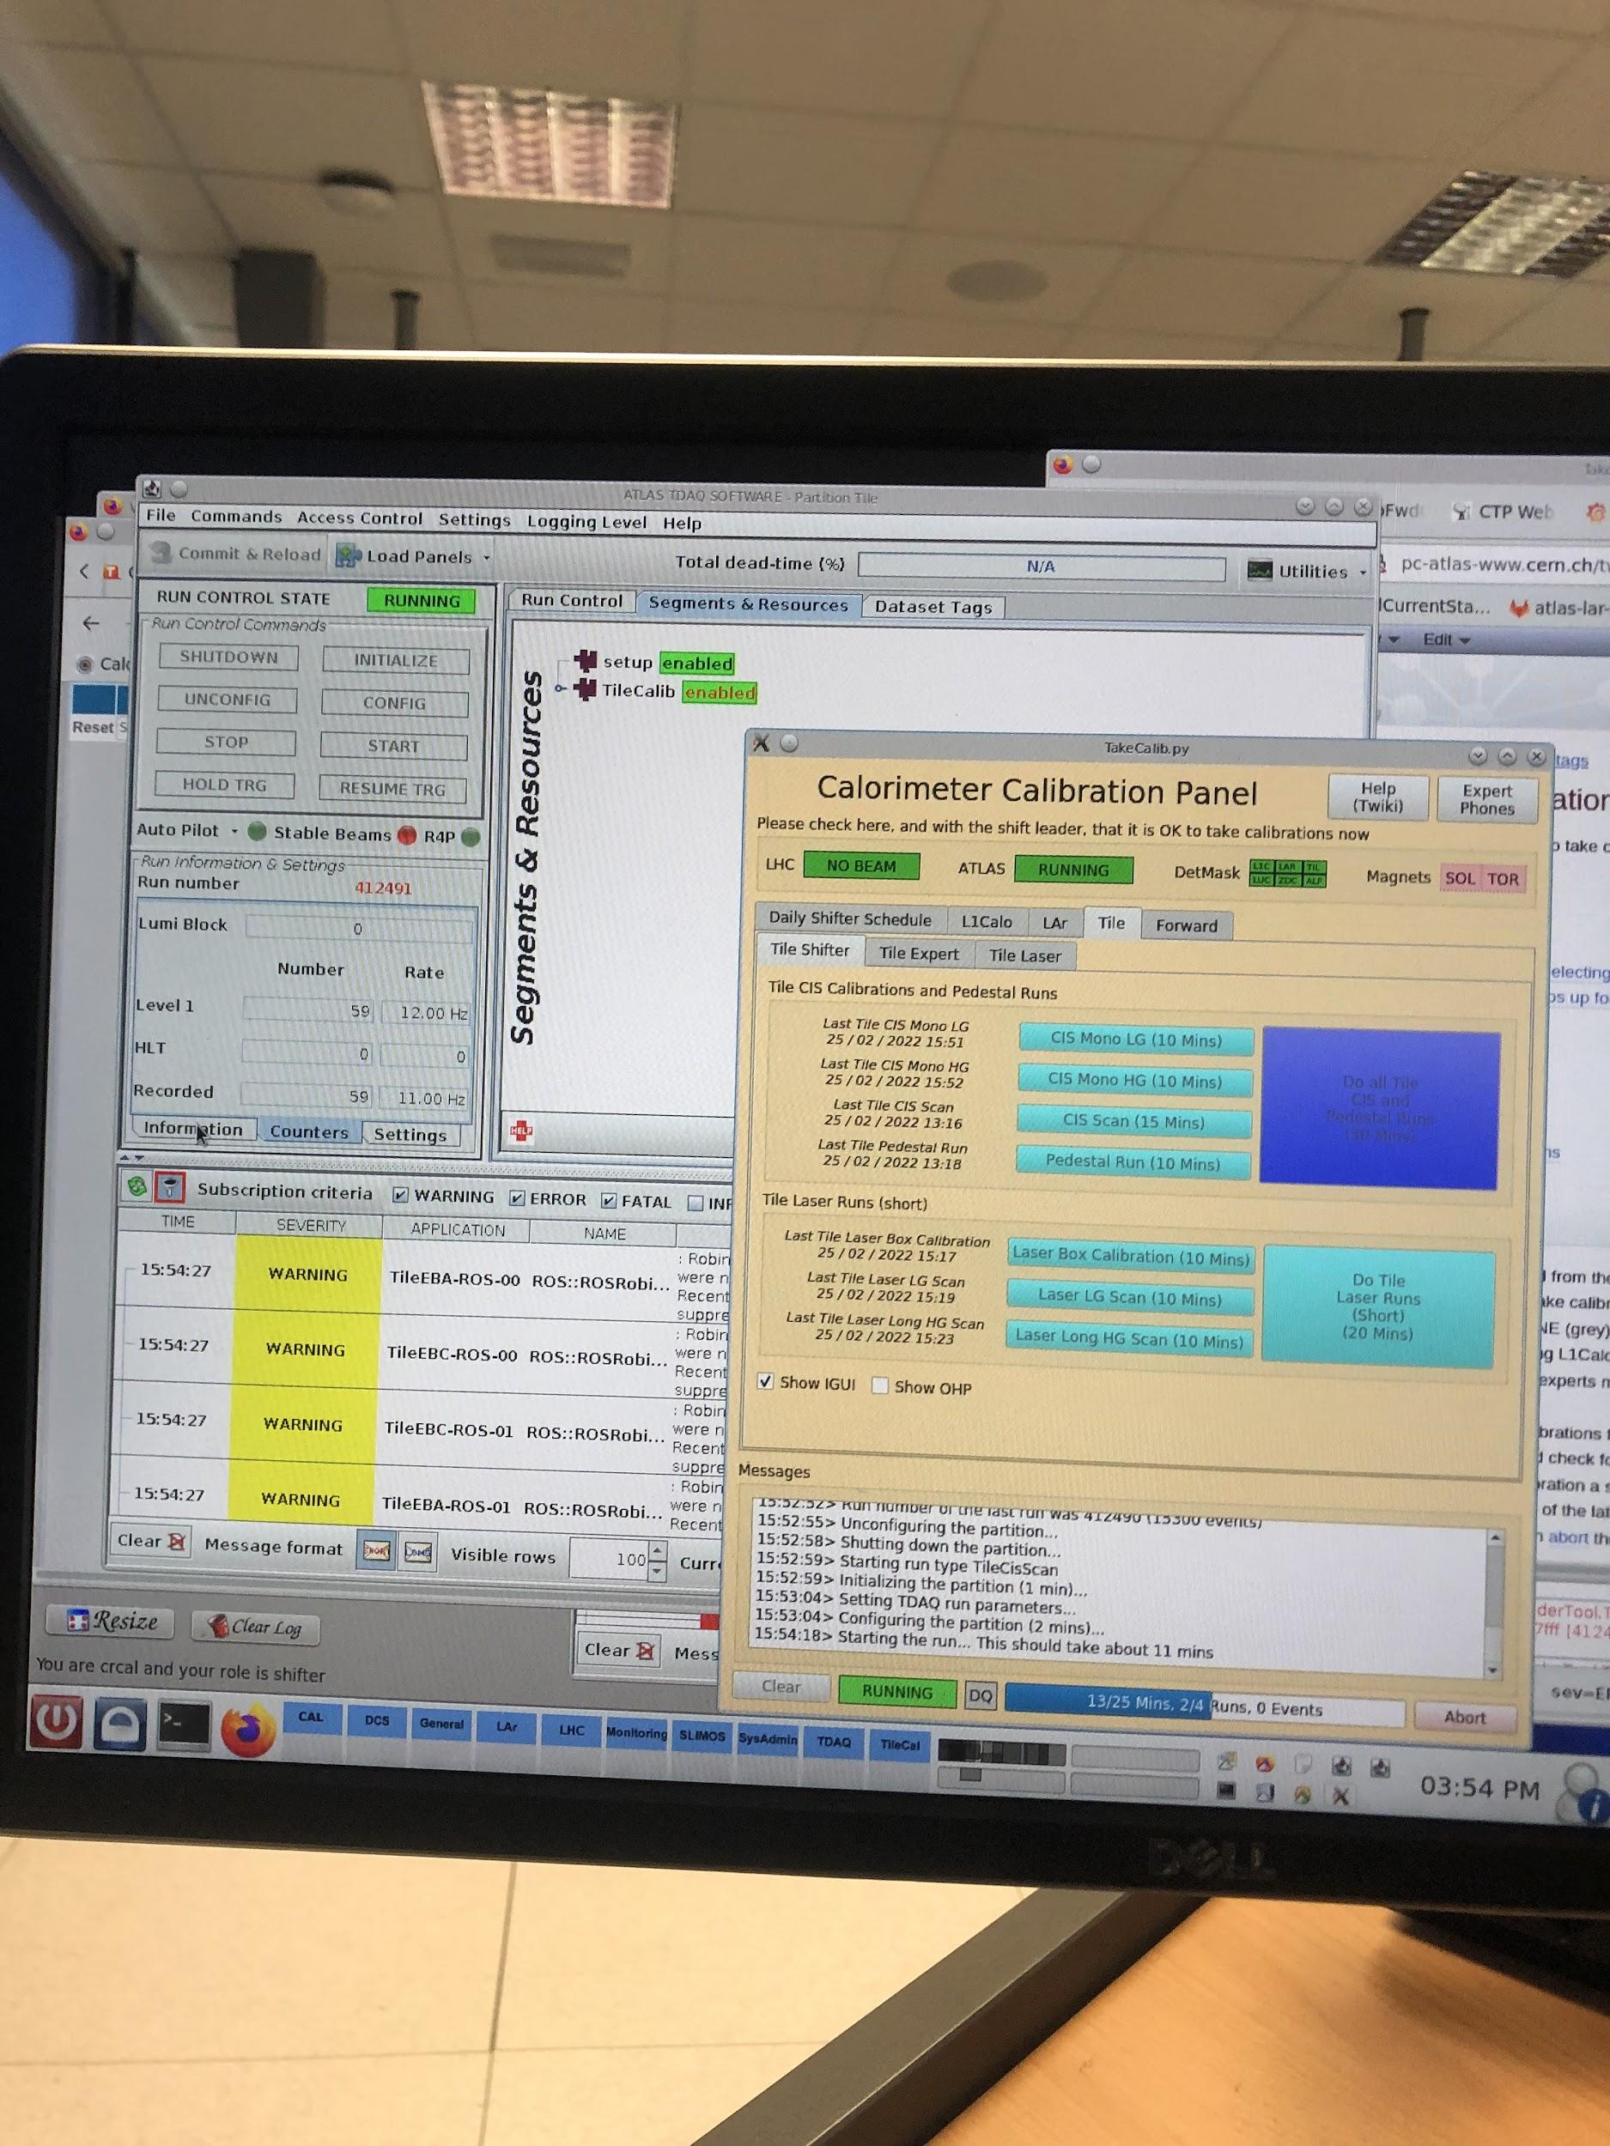
ACR Shifting
Katie has worked 9 shifts at the Calo/FWD desk, starting from late February!
Roles
Monitor detector status / alarms
Take calibration runs (occasionally)
Call experts if problems arise
Communicate information to next shifter

Slide 23
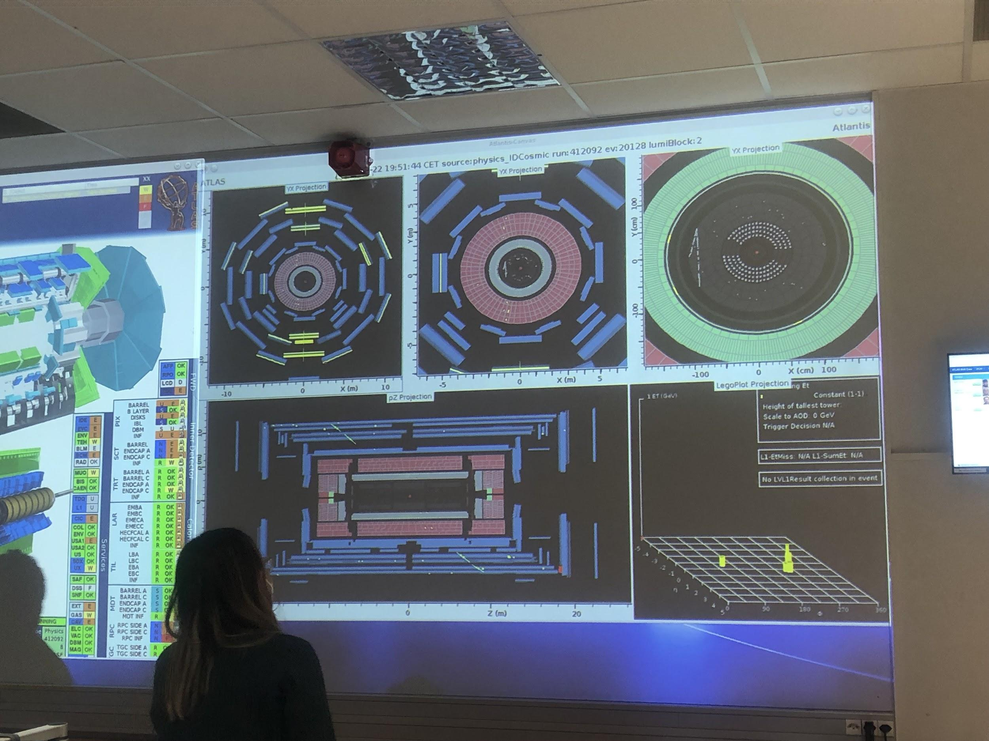
Muons in the overnight cosmics run in Feb.!

Slide 24

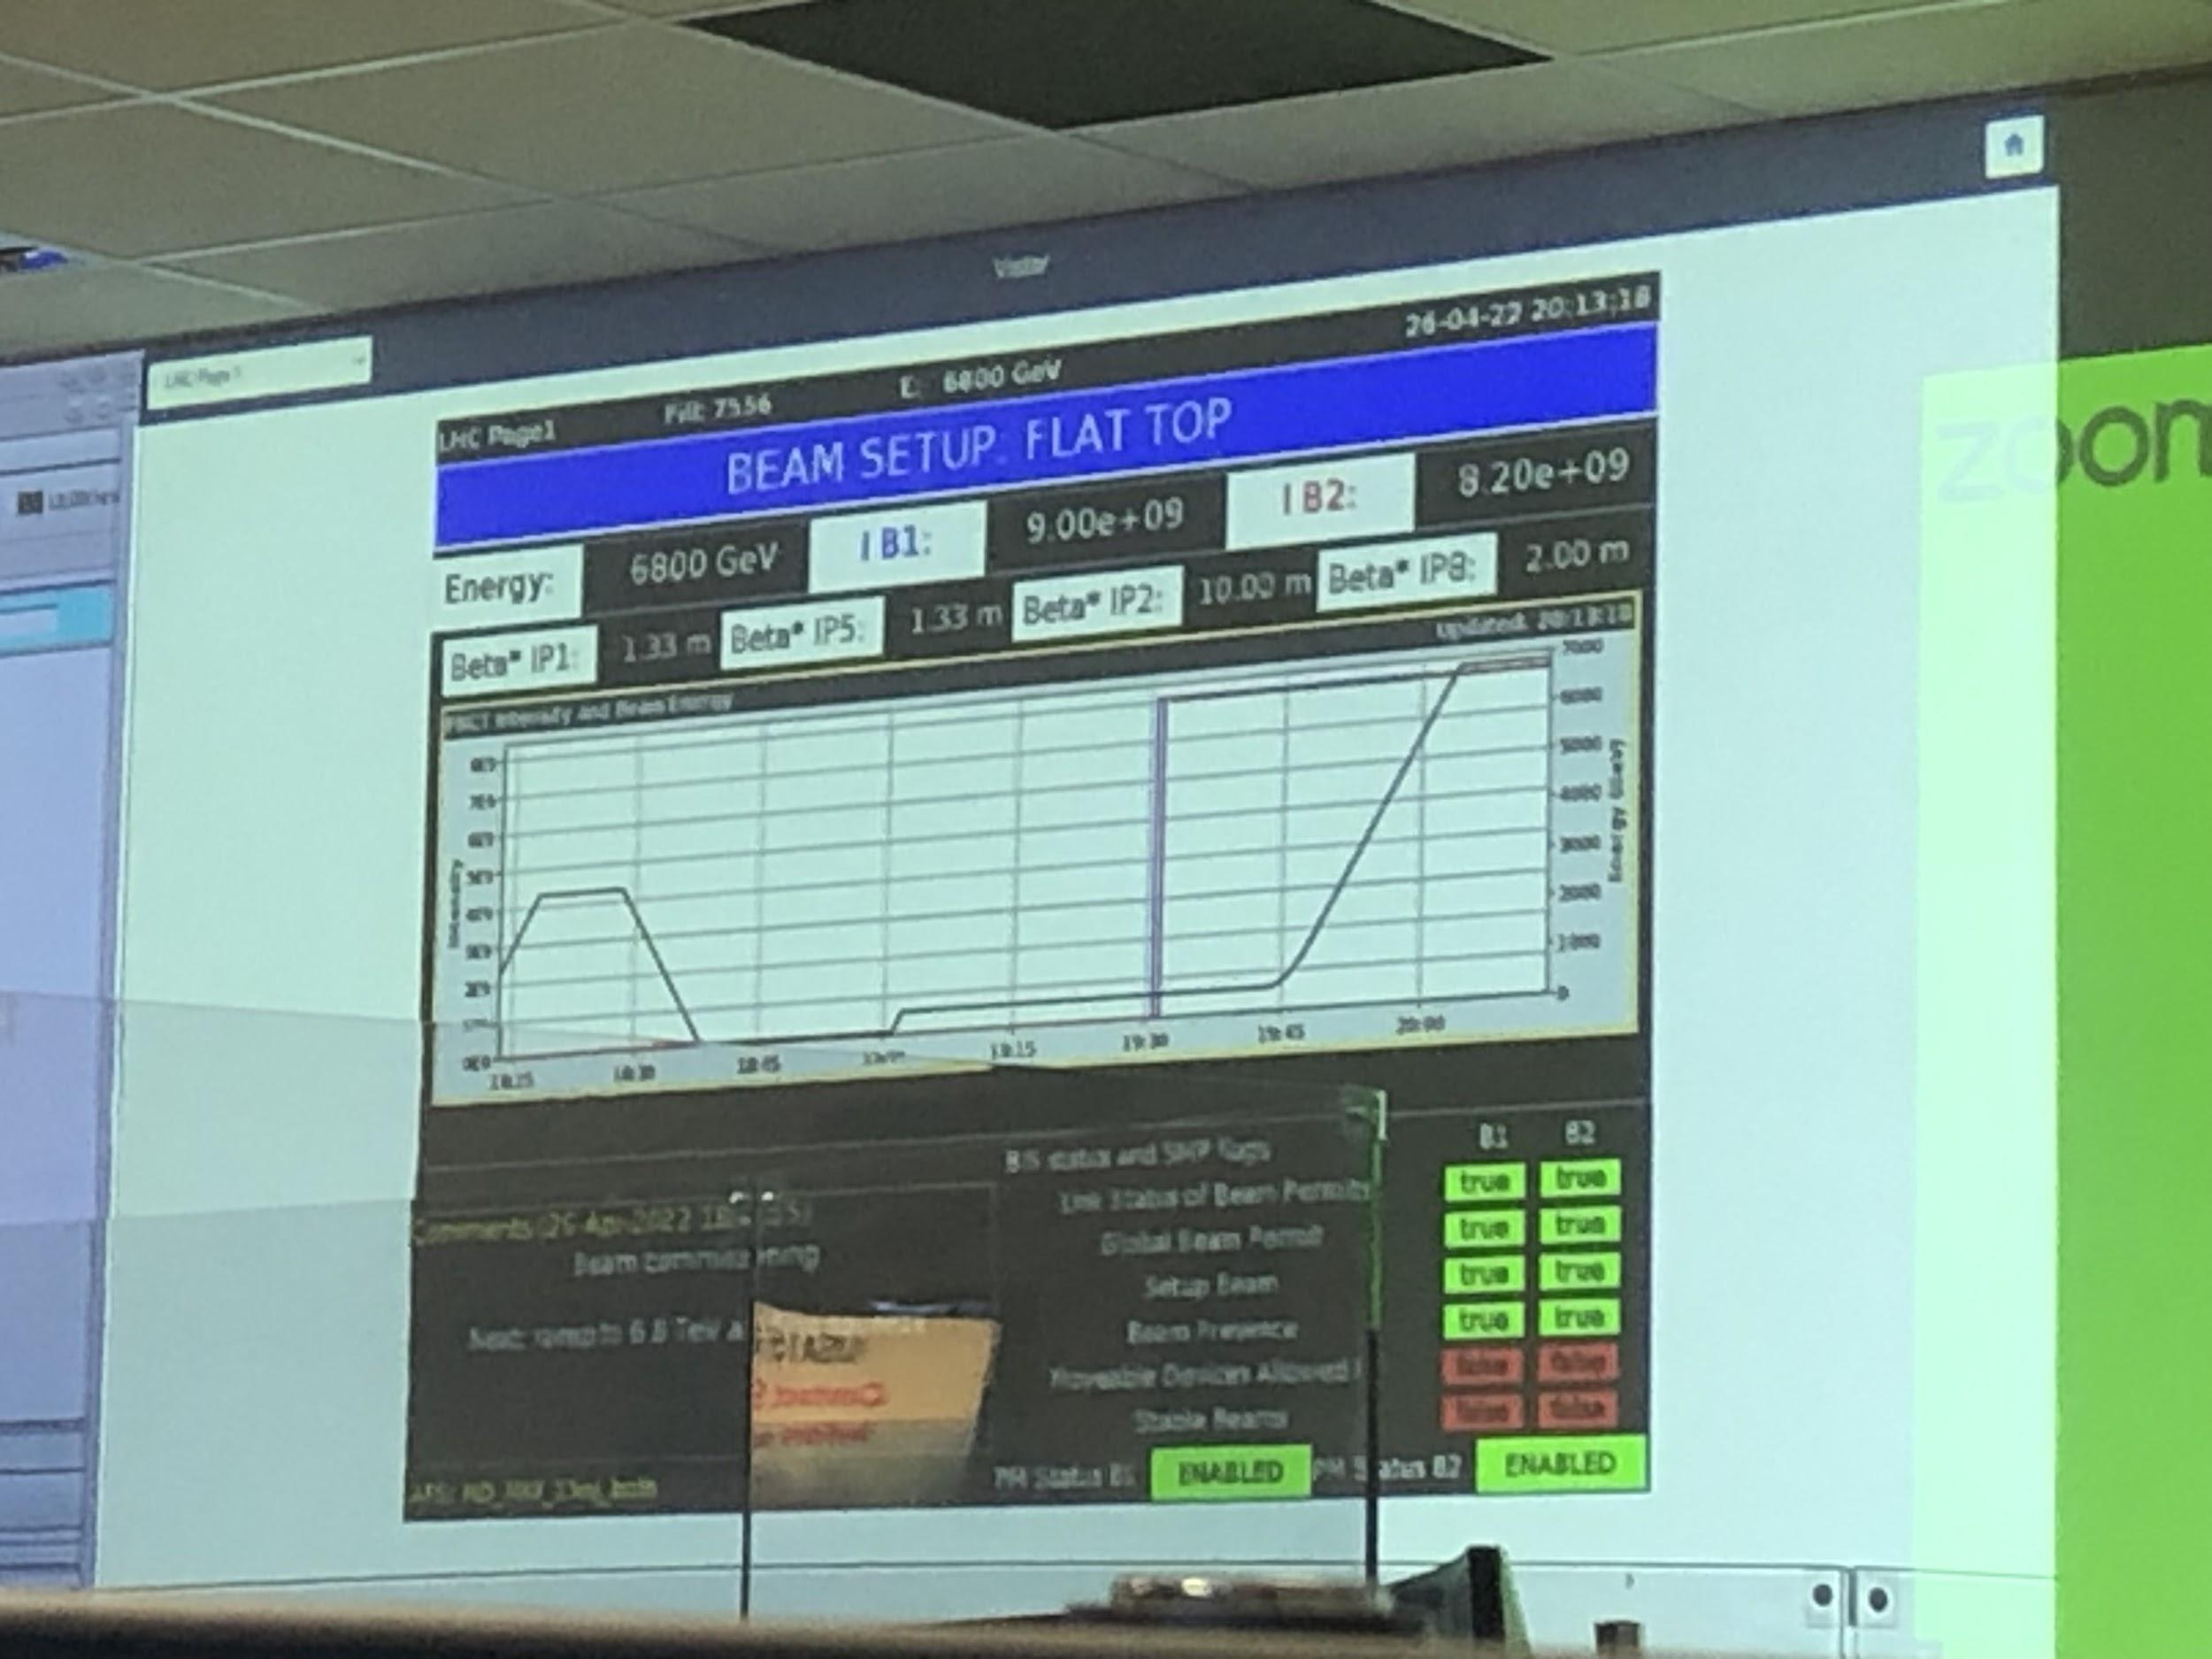
Beam alert sound that went off periodically, scaring me every time
Beam was active during my April shift – 6.8 TeV!!!

Slide 25
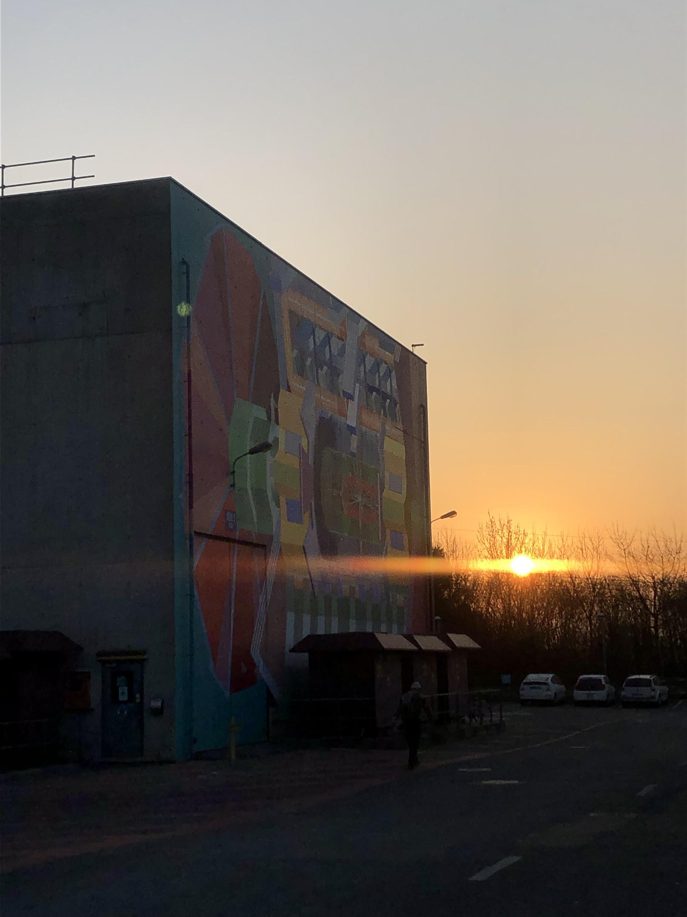
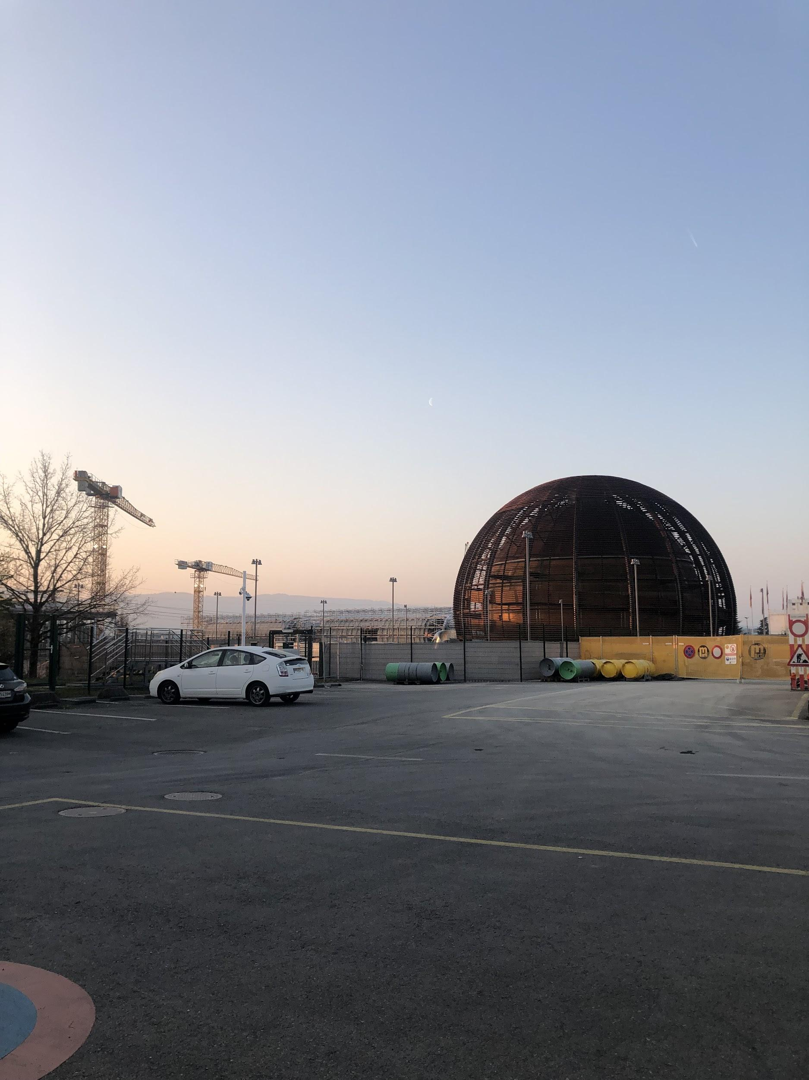
Sunrise after leaving overnight shifts

Slide 26
LAr Simulation Work

Slide 27
Energy Correction due to Accordion Structure
Motivation for the work:
ATLAS geometry is complicated which makes simulation jobs slow
Solution to this problem: FastCaloSim framework
It provides fast simulation of particle energy response of ATLAS detector by simplifying the geometry
In particular, accordion feature in LAr Calo is replaced by prismatic cells
We want to account for effects of accordion structure on the energy response of LAr detector post FastCaloSim processing
Goal:
To obtain a statistical model of layer energy modulation as a function of phi arising from accordion structure of LAr Calorimeter.
Final product: A functional form (TGraph) for the layer energy modulation in each EM layer of LAr Calo
Strategy: Use muon events generated at the center of detector to sample layer energy dependence on phi

Slide 28
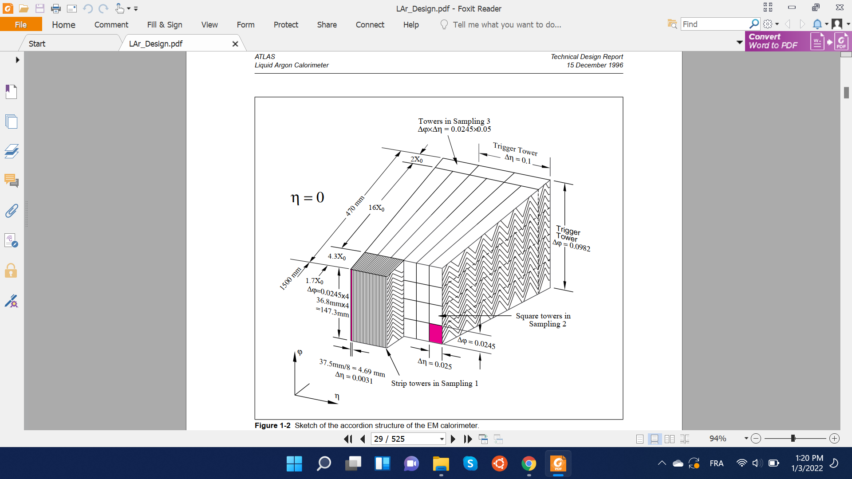
Accordion Structure & FastCaloSim
FastCaloSim is a framework that provides fast simulation of particle energy response of ATLAS detector.
Key simplification for fast simulation in LAr EM layers: idealize accordion wiggles by prismatic cells in 3D space
Run physics on idealized detector geometry
Correct for accordion effect on energy deposition at the end
To implement correction, we need to understand the phi dependence of energy deposition arising from the accordion structure.

Slide 29
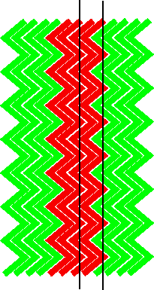
Non-homogeneous Electric Fields
Electric Field between cathode and anode plates not perfectly homogenous due to zig-zag shape of accordion structure
Affects how much Ionization of LAr medium is collected
Thus, the layer energy response of the detector is periodically modulated as a function of the phi value of particle trajectory.
r
φ

Slide 30
Input Statistics
Muons (|Pdg = 13|) generated at the center of detector with
CME of 100 Gev
0 < phi < 2𝝅 & 0.2 < |eta| < 0.25
Eta range does not cover the whole of EM layers; used for testing purposes for now
Advantages of Muons: Heavier mass means more localized energy depositions (compared to electrons or photons). This gives us better phi precision during our scan.
Disadvantage of Muons: Heavier mass means muons deposit on average only 3-4 Gev with minimal ionization. This, in-turn, increases our energy uncertainty, requiring larger size of input data.
Muon event selection: We are only interested in Muon events that mainly deposit energy through MIPs. Other forms of deposition, for example, photon-radiation contribute to uncertainty in energy deposited at a particular phi value.
Therefore, we only keep muons with high enough final energies (E > 92 Gev).

Slide 31
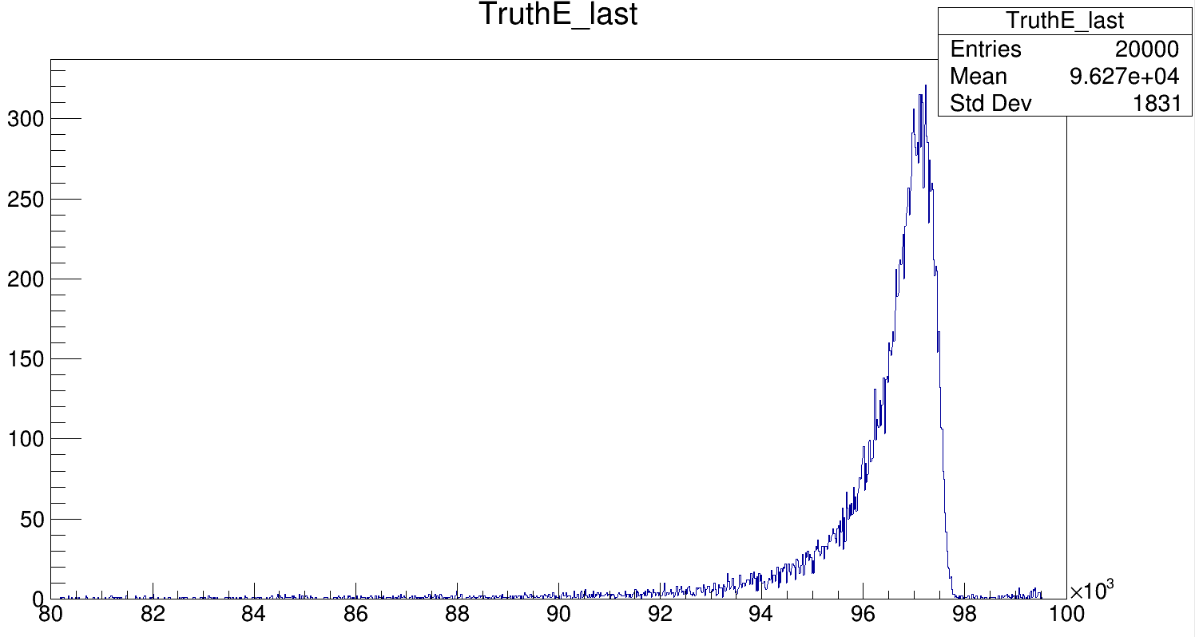
Final Truth Energy of Muons
Selected events
Region of large non-MIP energy deposition
E (Mev)

Slide 32
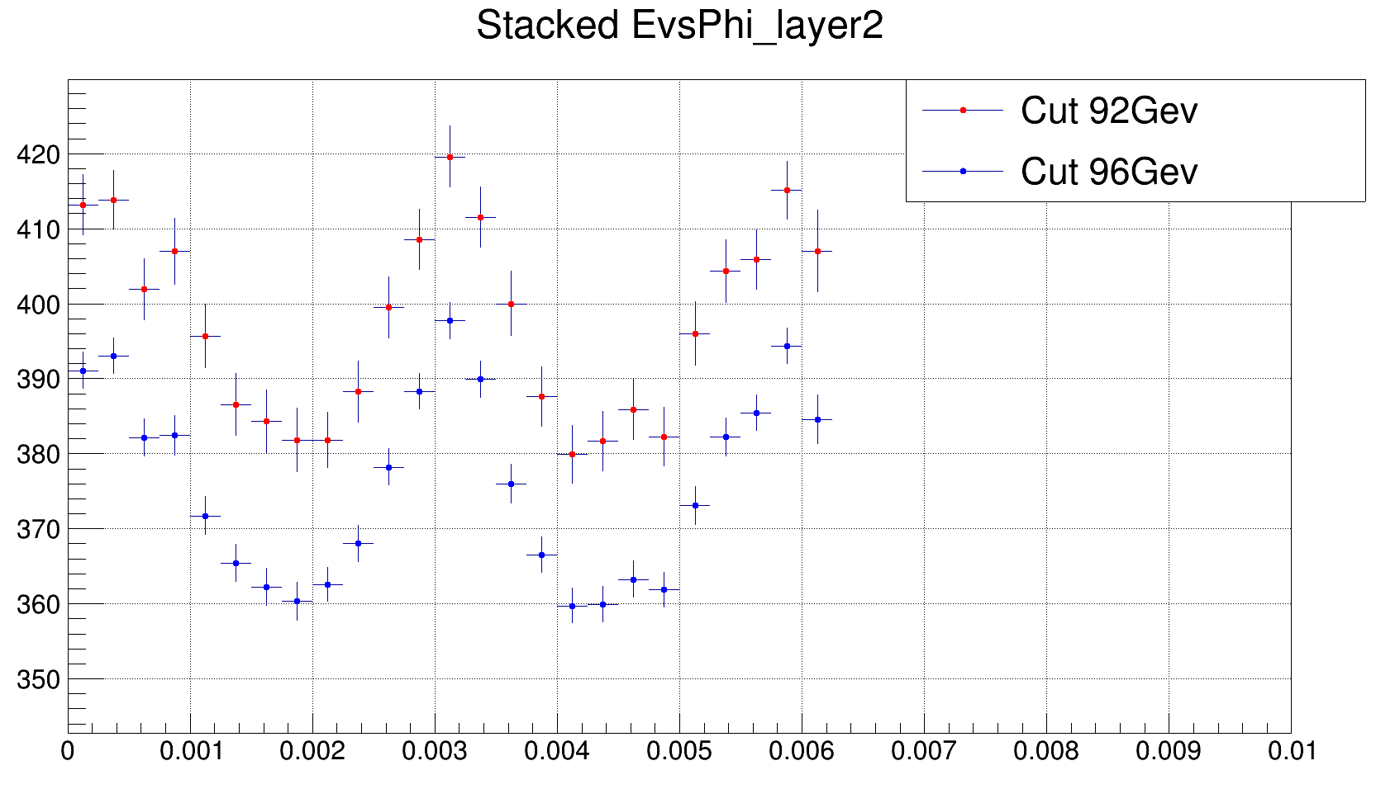
Result
E [Mev]
Result for Layer 2 of LAr EM layers. Most important for this work as it is the layer with the most phi partitions.
φ

Slide 33
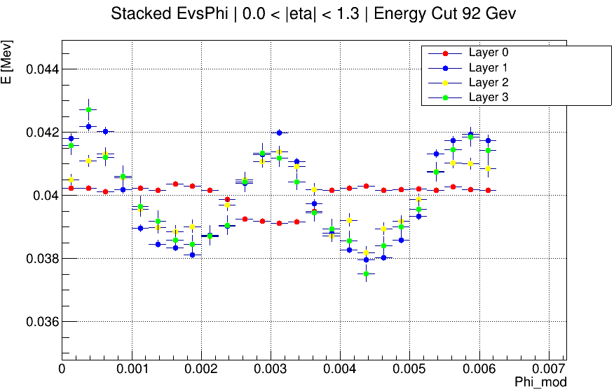
Results Con’t
0.0 < |eta| < 1.3
[8 Million events] input events]

Slide 34
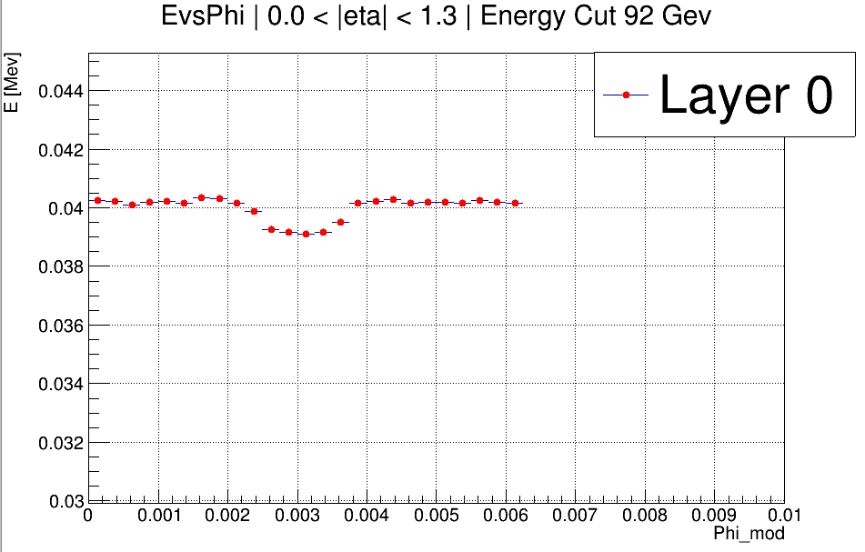
Results Con’t
0.0 < |eta| < 1.3
[8 Million events] input events]

Slide 35
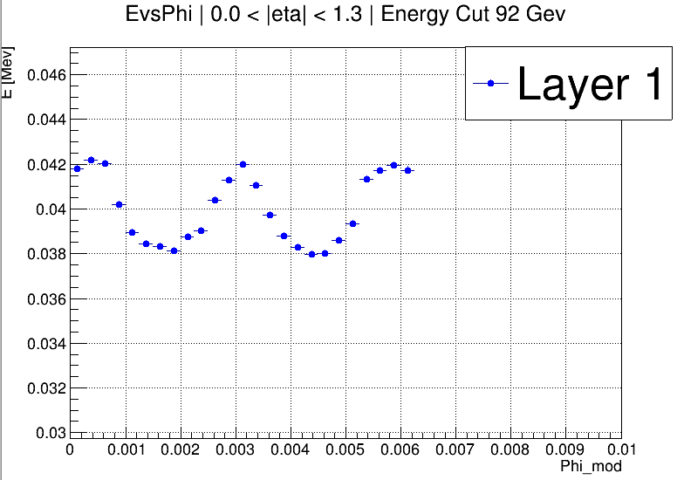
Results Con’t
0.0 < |eta| < 1.3
[8 Million events] input events]

Slide 36
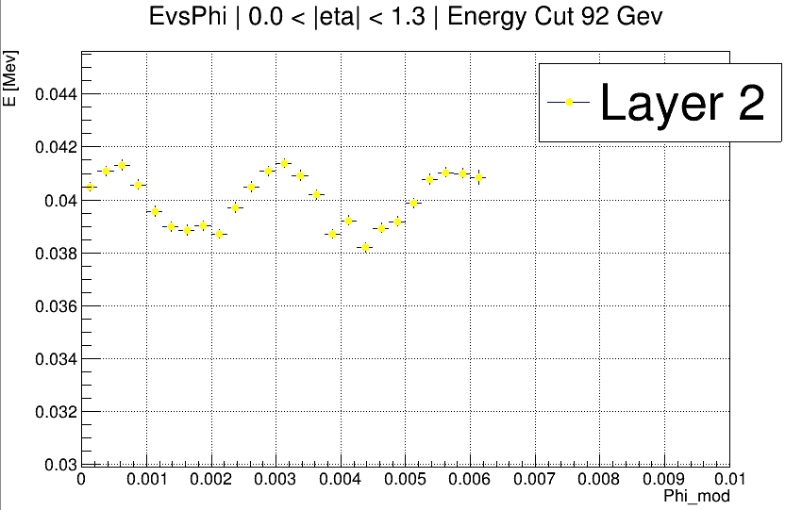
Results Con’t
0.0 < |eta| < 1.3
[8 Million events] input events]

Slide 37
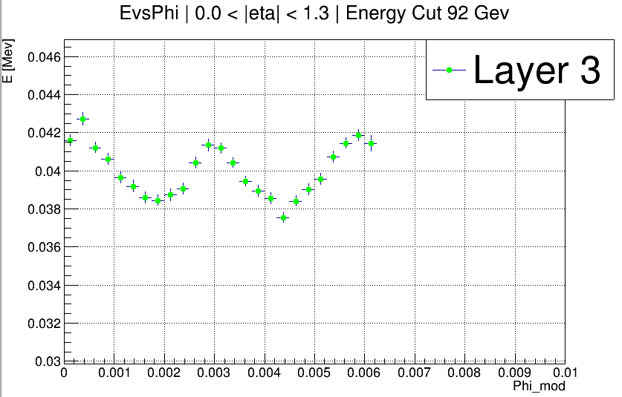
Results Con’t
0.0 < |eta| < 1.3
[8 Million events] input events]

Slide 38
Life Updates

Slide 39


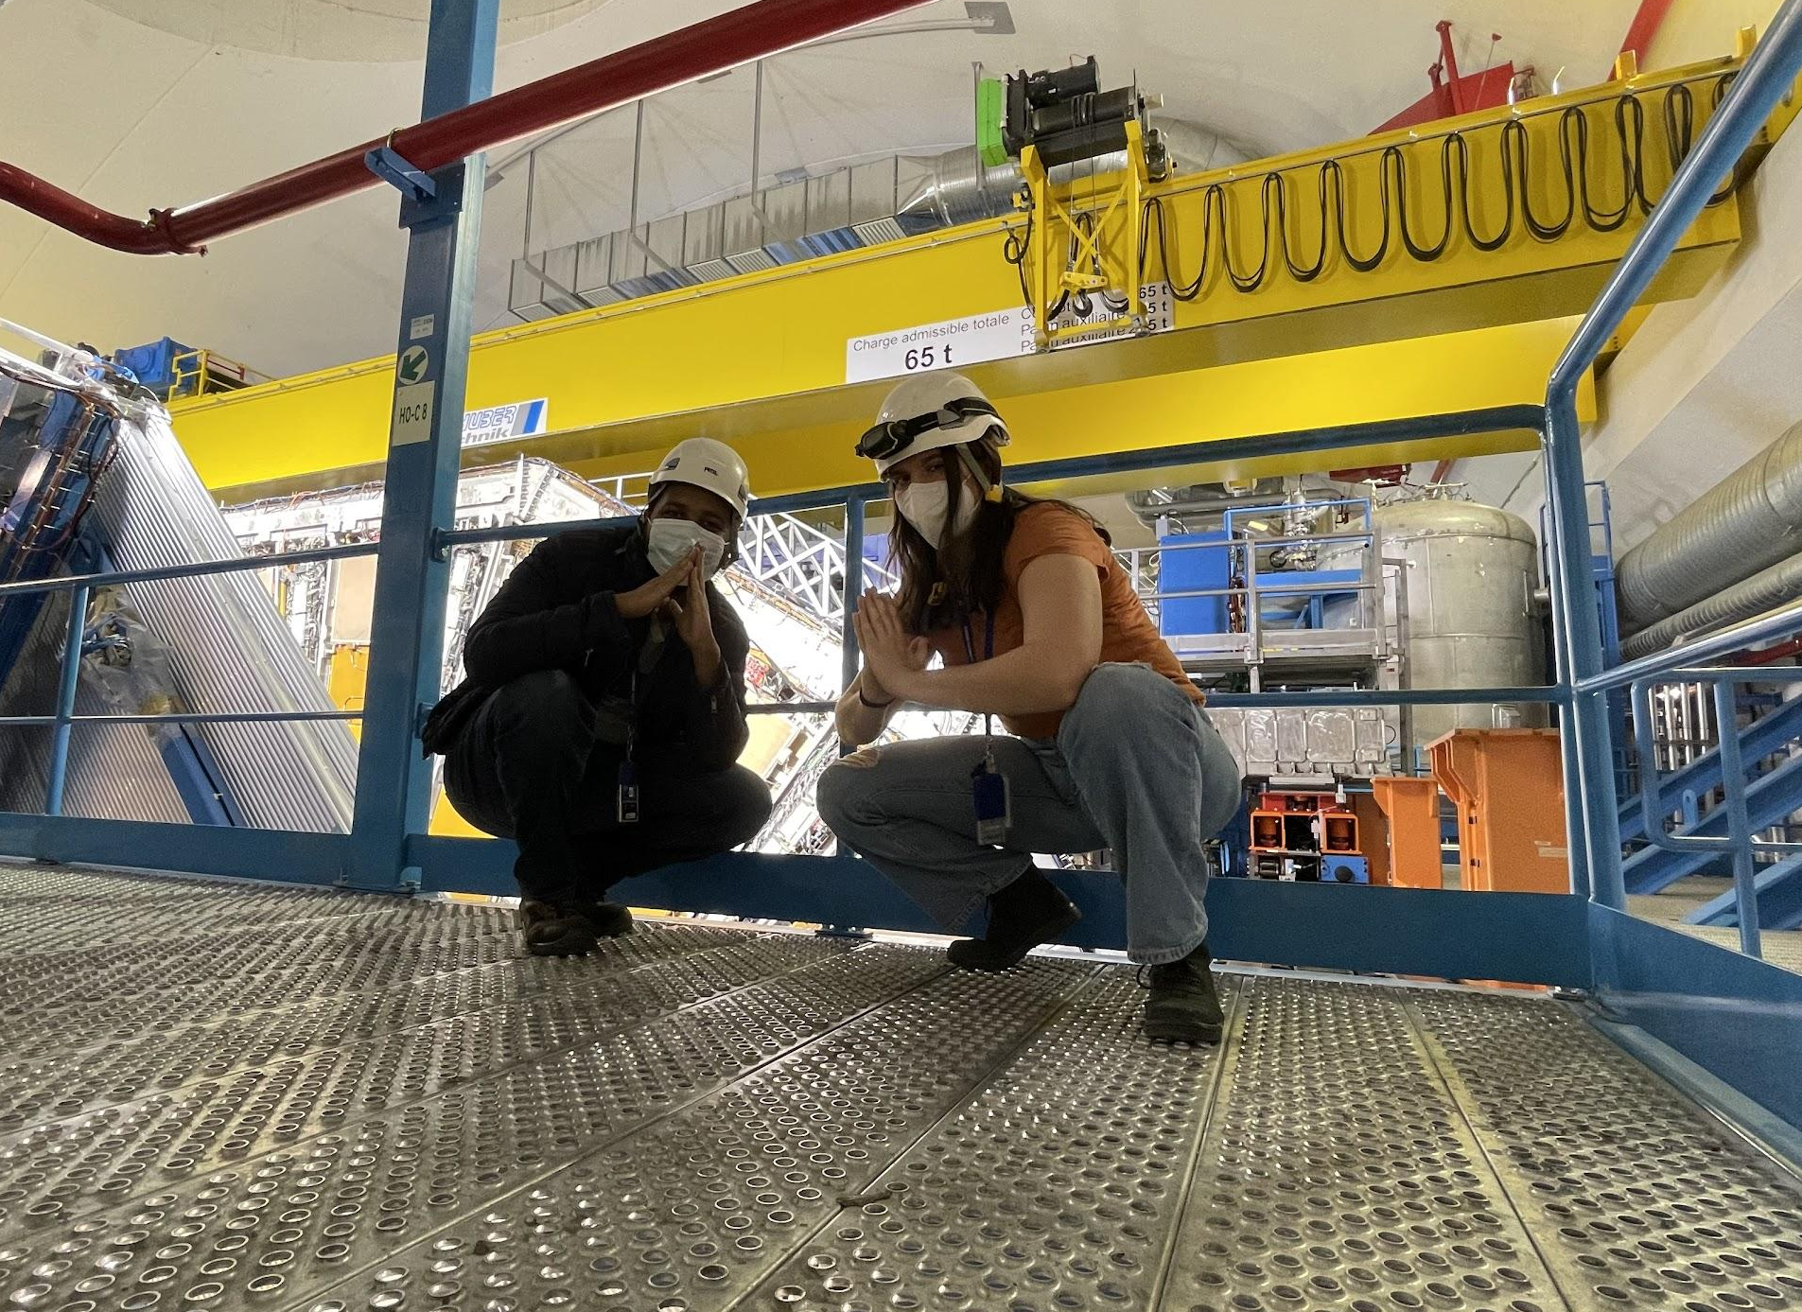
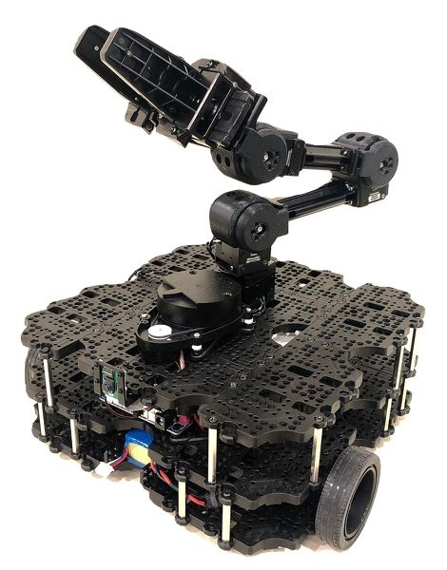

Dawit will do a Masters in Theoretical Physics next year at Perimeter Institute (University of Waterloo)!
Katie will do a Masters in Robotics next year at Northwestern!
We have new techs coming in the end of June, Peter Camporeale and Jacky Li!

Slide 40
Thank You!

Slide 41
Unusually High # of High Deviation Channels
61 channels in the update have >|5%| change:
45 come from demonstrator LBA_m14 (around 20-40% change)
12 come from EBC_m43_ch36-41 (All around 50% change! These channels were at half gain levels during the last CIS update, but have now returned to normal levels…)
Remaining 4 channels are already far from detector average, and have deviations around 5-10% (normal)

Slide 42


High Deviation Channels (LBA14)
LG drop in value (to 0), HG rises in value.
Sasha

Slide 43


High Deviation Channels (EBC_m43_ch36-41)
New CIS constant reflects most recent value

